Slide 1
IGNITE
THE GAMING PLATFORM
Mentor Mr. Naresh Chandra
Team Members
Mayank Agrawal
Rishabh Sharma
Pramod Pandey
Priyanka Sharma
Presented To-
Mr. Vipin Sir
Mr. Naresh Chandra
Presented By-
Rishabh Sharma

Slide 2
Overview Of Ignite
Ignite is going to act as an Information platform for the young gamers who want to spend their time in gaming and want to be esports player. Our project will give you following details:-
Game Description.
platforms : Xbox , PlayStation , pc, mobile.
Rating.
Ingame screenshots.

Slide 3
Impact of Gaming on Society
Awareness: Acknowledging Gaming Industry (the gaming industry generated $155 billion in revenue in 2020)
Recognition: Realization of gaming as a career.
Technology: Next generation Technology Experience.
Education: Studies have found that video games can improve learning , Improved Brain Function

Slide 4
Technology used in our project
Bootstrap
Front-end framework
Redux
JavaScript library
RAWG
Games Database API
Heroku
Cloud Application Platform
MongoDB
Express JS
React JS
Node JS

Slide 5
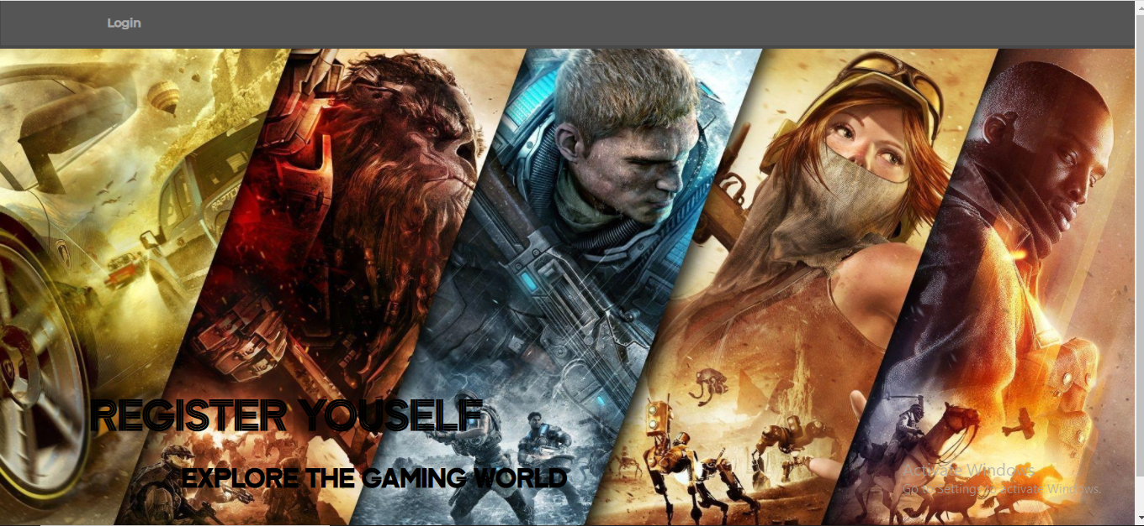
LANDING PAGE

Slide 6
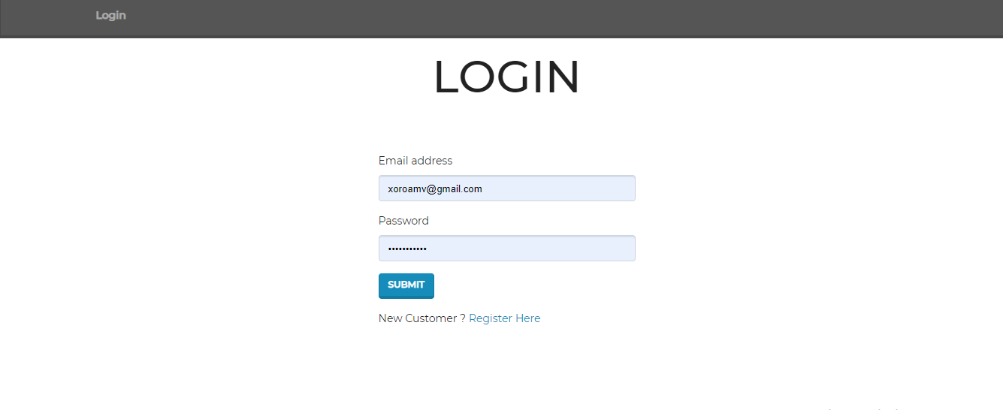
LOGIN PAGE

Slide 7
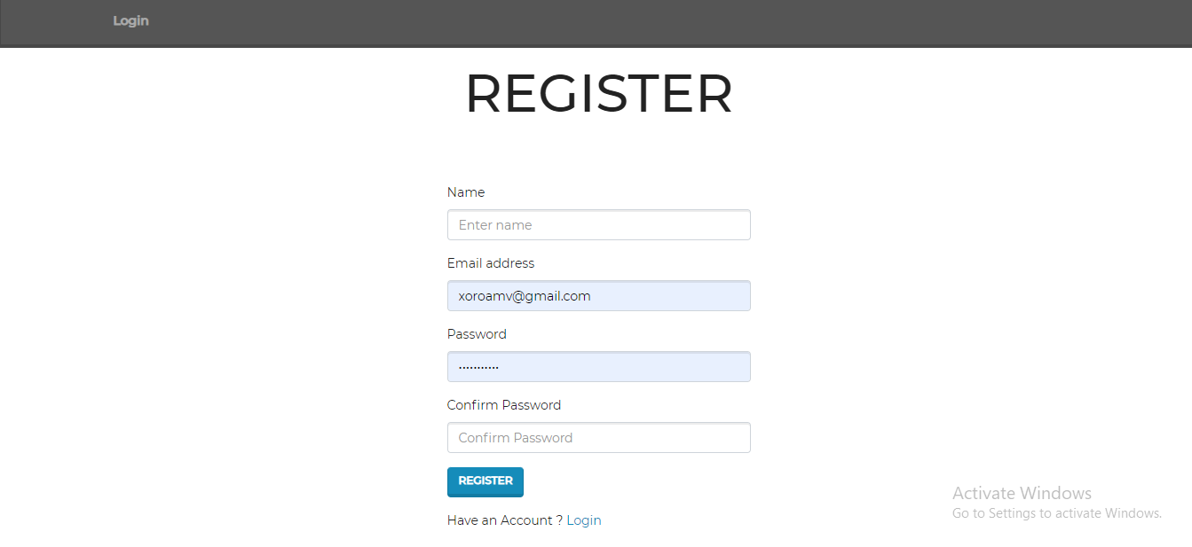
REGISTRATION PAGE

Slide 8
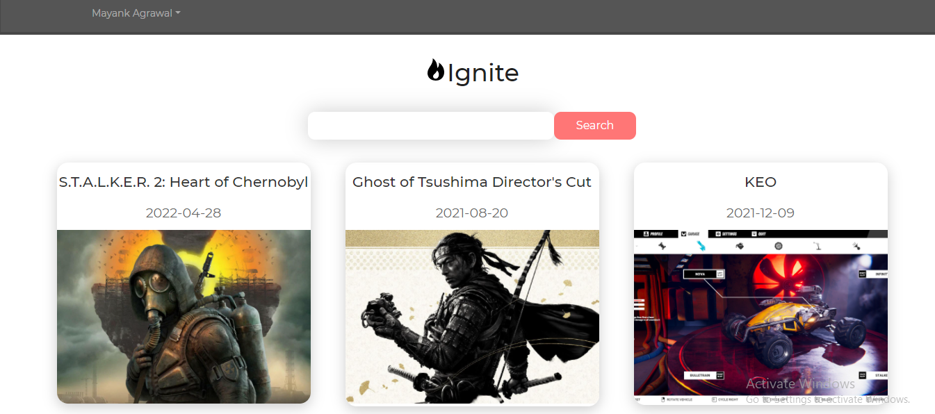
HOME PAGE

Slide 9
PROJECT LINKS
GITHUB (SOURCE CODE)
https://github.com/MittalMayankAgrawal/ignite-mern
HEROKU (DEPLOYED PROJECT )
https://ignitegamingplatform.herokuapp.com/

Slide 10
THAT’S ALL FROM OUR SIDE THANK FOR HAVING US

